Slide 1
Firewall

Slide 2
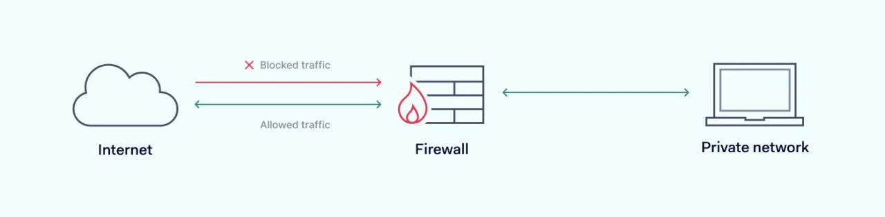
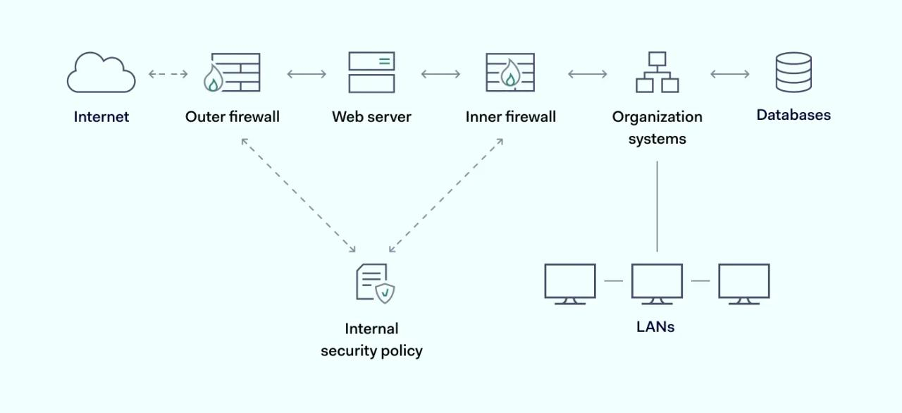
Firewall
Firewalls can be viewed as gated borders or gateways that manage the travel of permitted and prohibited activity in a private network.

Slide 3
Types
Based on System
Hardware: Independent of the devices they protect
Software: Installed on the devices being protected
Based on Location
Network Firewall
Host Firewall

Slide 4
Packet filtering
IP address
Port
Data Transfer Protocol [Circuit Level Firewall]
Inspection Types
Stateful inspection
Static packet-filtering firewalls, also known as stateless inspection firewalls

Slide 5
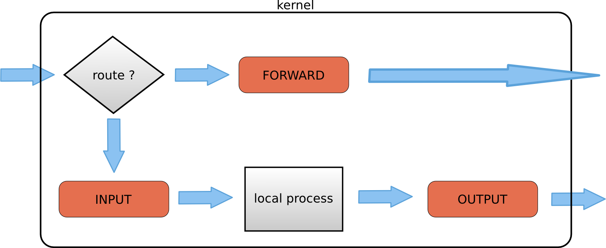
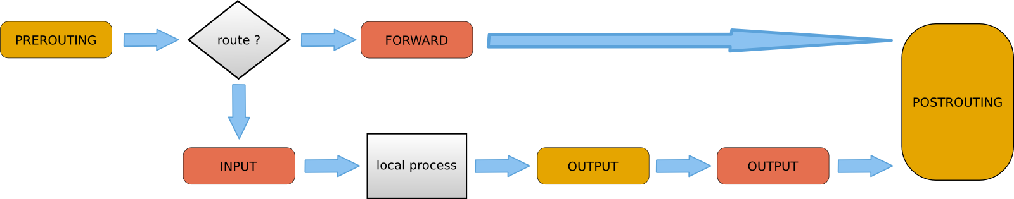
IP table filter
Copied from http://linux-training.be/networking/ch14.html

Slide 6
Deep Packet Inspection Firewall
Deep packet inspection (DPI), also known as packet sniffing, is a method of examining the content of data packets as they pass by a checkpoint on the network.
Proxy Firewall

Slide 7
Web Application Firewall
A WAF or web application firewall helps protect web applications by filtering and monitoring HTTP traffic between a web application and the Internet.

Slide 8
IDS
Signature
Pattern
IDS
Detection
Anomaly
Statistical
Rule based
Location
ML/DL
Host IDS
Network IDS
Analysis
Graph Based
Anti-Virus
Sandbox
Static
Dynamic
Signature
Anomaly
False Positive and False Negative – Important consideration

Slide 9
Firewall
Network
Circuit Level Firewall
Session
Firewall
Layers
Transport
Proxy Firewall
Location
Application
Web Application Firewall
Host
Network
Deep Inspection Firewall

Slide 10
Anti-Virus
Anti-Virus
Location
Host
Detection
Signature
Anomaly
Analysis
Static
Dynamic
Sandbox
Pattern
Statistical
Rule based
ML/DL
Graph Based

Slide 11
Difference
Parameters | HIDS | Anti-Virus | Layer 7 Firewall
Scope | Look into the internal process | Look into the internal process | Only at the Interface
Coverage | Network Packets, Files, Settings or Configurations | Files | Packet header and payload
Policy | Handle | Cannot Handle | Not Applicable
Q1. Do we need HIDS/HIPS and Anti-Virus for our device?
Ans: The Modern Anti-Virus is also having the features of HIDS/HIPS. Otherwise HIDS/HIPS is better than Anti-Virus. However, cost impacts.
Q2. Do we need HIDS/HIPS and Firewall for our device?
Ans: Even though HIDS performs task similar and more than the Firewall, the earlier filtering increase the performance of HIDS/HIPS.

Slide 12
Indicators of Compromise
Indicates a system may have been infiltrated by a cyber threat.
Unusual inbound and outbound network traffic
Anomalies in privileged user account activity
Other login red flags
Swells in database read volume
HTML response sizes
Large numbers of requests for the same file
Mismatched port-application traffic
Suspicious registry or system file changes
DNS request anomalies
Geographical irregularities
Virus Signature
Unexpected Software Installations
Large amounts of compressed files or data bundles in incorrect or unexplained locations
Indicators of Attack are active in nature and focus on identifying a cyber attack that is in process.
References- https://www.fortinet.com/resources/cyberglossary/indicators-of-compromise
https://www.crowdstrike.com/cybersecurity-101/indicators-of-compromise/

Slide 13
References
http://linux-training.be/networking/ch14.html
https://nordlayer.com/learn/firewall/what-is-firewall/
https://www.cloudflare.com/learning/ddos/glossary/web-application-firewall-waf/

